Slide 1
NYSAFLT
Summer Institute
August 2015
Laurie Clarcq lclarcq@yahoo.com

Slide 2
If you had to illustrate
“visualization”
What would it look like?

Slide 3
Have someone read the following 3 slides
to you in English:
Write or draw what you hear for each slide.
© LClarcq 2015

Slide 4
1. baby
© LClarcq 2015

Slide 5
2. The big dog is riding in the front seat.
© LClarcq 2015

Slide 6
3. The painting of Sinatra that I had painted is hanging above the small table. I put the two huge sunflowers on the table in a big plastic water cooler jug.
© LClarcq 2015

Slide 7
The purpose of language,
as used in communication,
is to create a picture
in the mind and/or the heart
of another person.
© LClarcq 2015

Slide 8
Did you “picture”......
© LClarcq 2015

Slide 9
1. baby
or
© LClarcq 2015

Slide 10
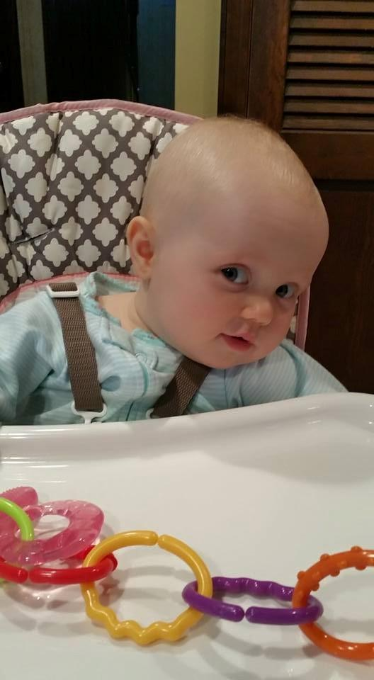
© LClarcq 2015

Slide 11
2. The big dog is riding in the front seat.
or
© LClarcq 2015

Slide 12
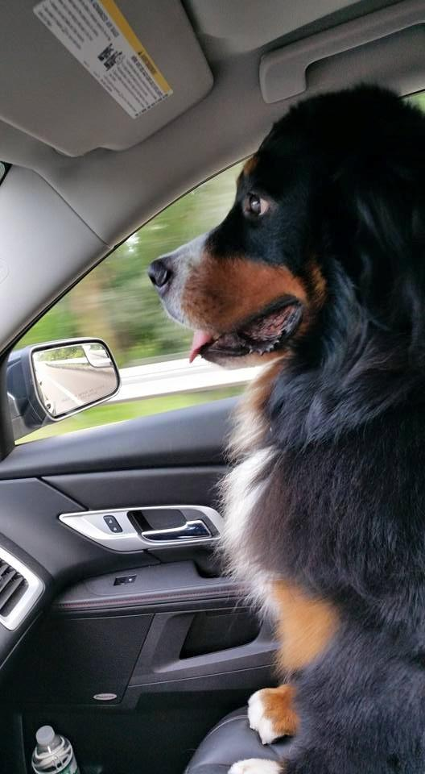
© LClarcq 2015

Slide 13
3. The painting of Sinatra that I had painted is hanging above the small table. I put the two huge sunflowers on the table in a big plastic water cooler jug.
or
© LClarcq 2015

Slide 14
© LClarcq 2015

Slide 15
Visualization
is a
© LClarcq 2015
Notes:
Draw your idea of visualization

Slide 16
Skill
© LClarcq 2015

Slide 17
A skill
that improves
with practice!!
© LClarcq 2015

Slide 18
A valuable skill
that improves
with practice!!
© LClarcq 2015

Slide 19
“ Individuals of all ages may experience the symptoms of a weakness in “concept imagery.”
This causes weakness in:
Reading comprehension
Listening comprehension
Critical thinking and problem solving
Following directions
Memory
Oral language expression
Written language expression
Grasping humor
Interpreting social situations
Understanding cause and effect
Nanci Bell
Co-founder of Lindamood-bell

Slide 20
bebé

Slide 21
baby

Slide 23
bebé
bebe

Slide 24
Students need to know two things:
1. Everything should
be visualized.
© LClarcq 2015

Slide 25
Students need to know two things:
2. Everything visualized
should be checked.
© LClarcq 2015

Slide 26
Does it work?
Does it make sense?
If not, find the problem!
© LClarcq 2015

Slide 27
George bebe café.
© LClarcq 2015

Slide 28
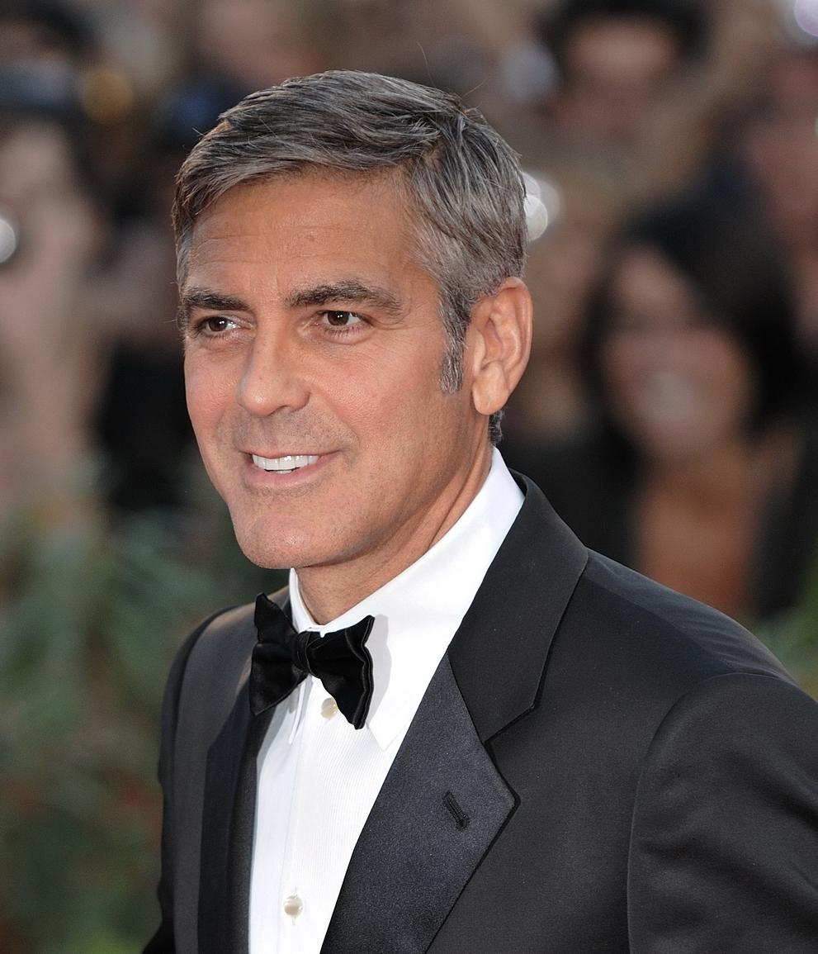
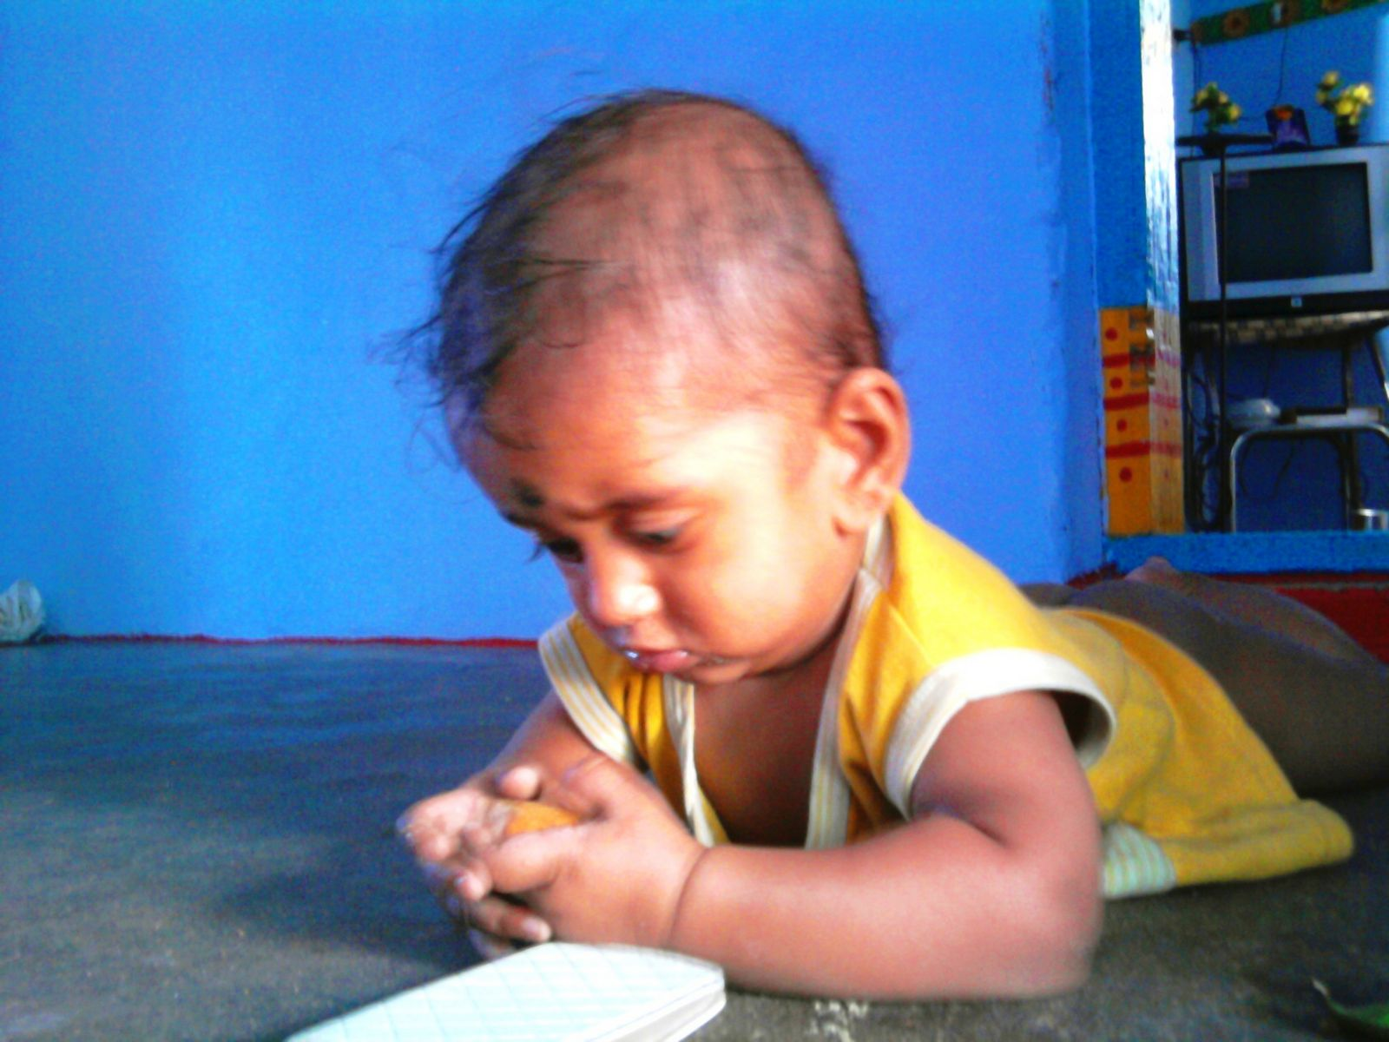
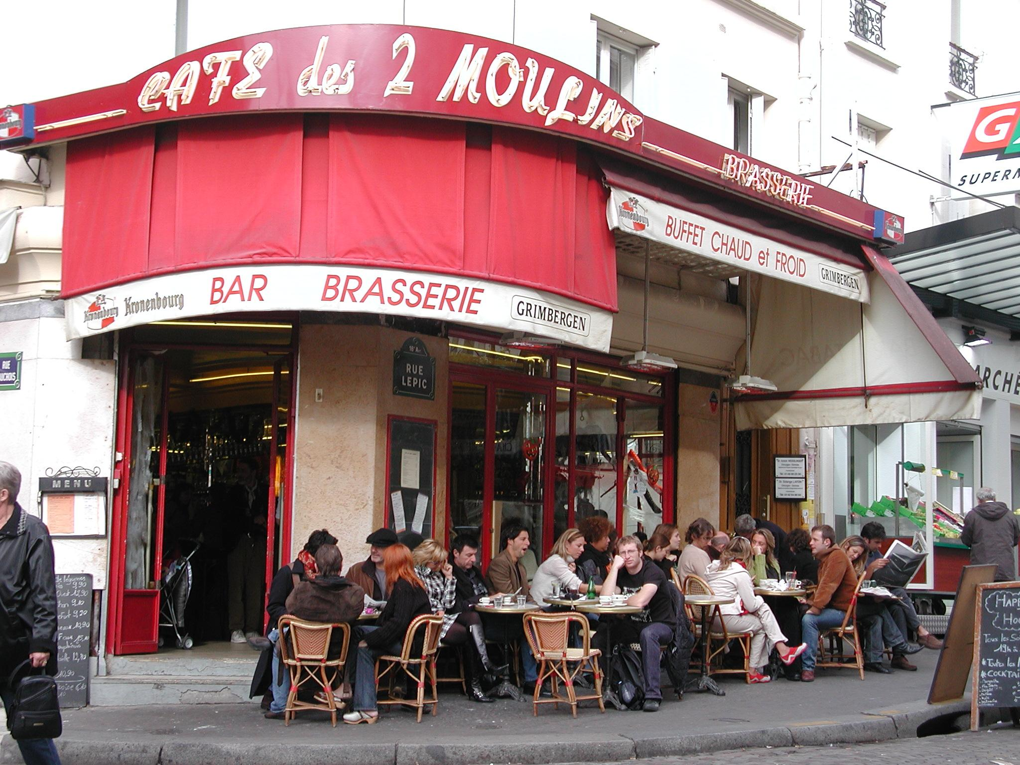

Slide 29
Does it work?
Does it make sense?
If not, find the problem!
© LClarcq 2015

Slide 30
George bebe café.
© LClarcq 2015

Slide 31
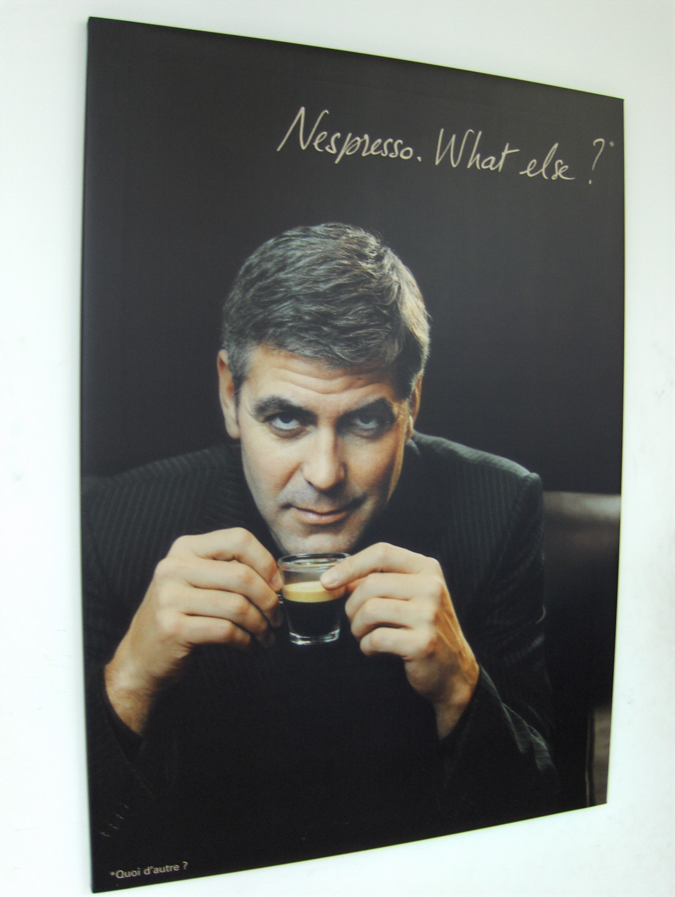

Slide 32
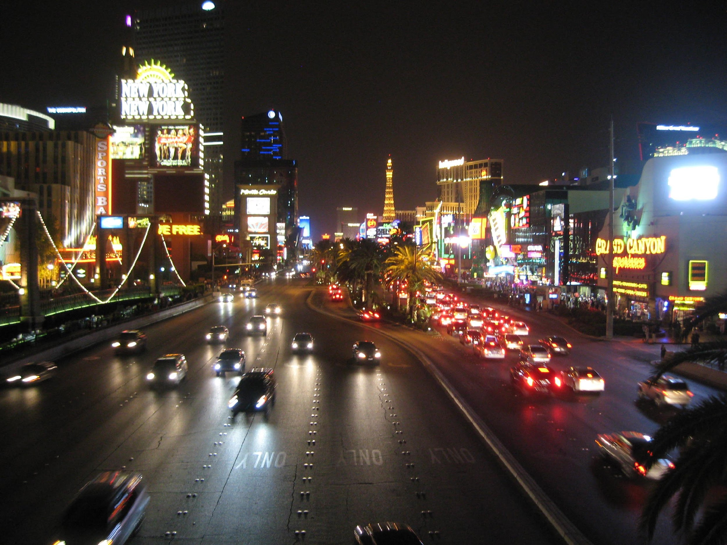
Laurie i Jose yedut v
Las Vegas

Slide 33

Create gesture for each phrase on the next slide. Do the gesture as you (or the teacher) reads the story.

Slide 34
Eta Laurie. This is Laurie.
U Laurie yest’ Chihuahua. Laurie has a Chihuahua.
Eta Jose. This is Jose.
Jose i Laurie yedut v Las Vegas. Laurie and Jose go to Las Vegas.
Laurie igrayit v igraviye auftomati. Laurie plays the slot machines.
Jose rad. Jose is happy.
© LClarcq 2015

Slide 35
How does having the gesture, or seeing another person use the gesture add to interest and aid comprehension?
Go through the PowerPoint presentation labeled
Jose and Laurie and return to this slide.
How did the visuals add to interest and aid comprehension?

Slide 36
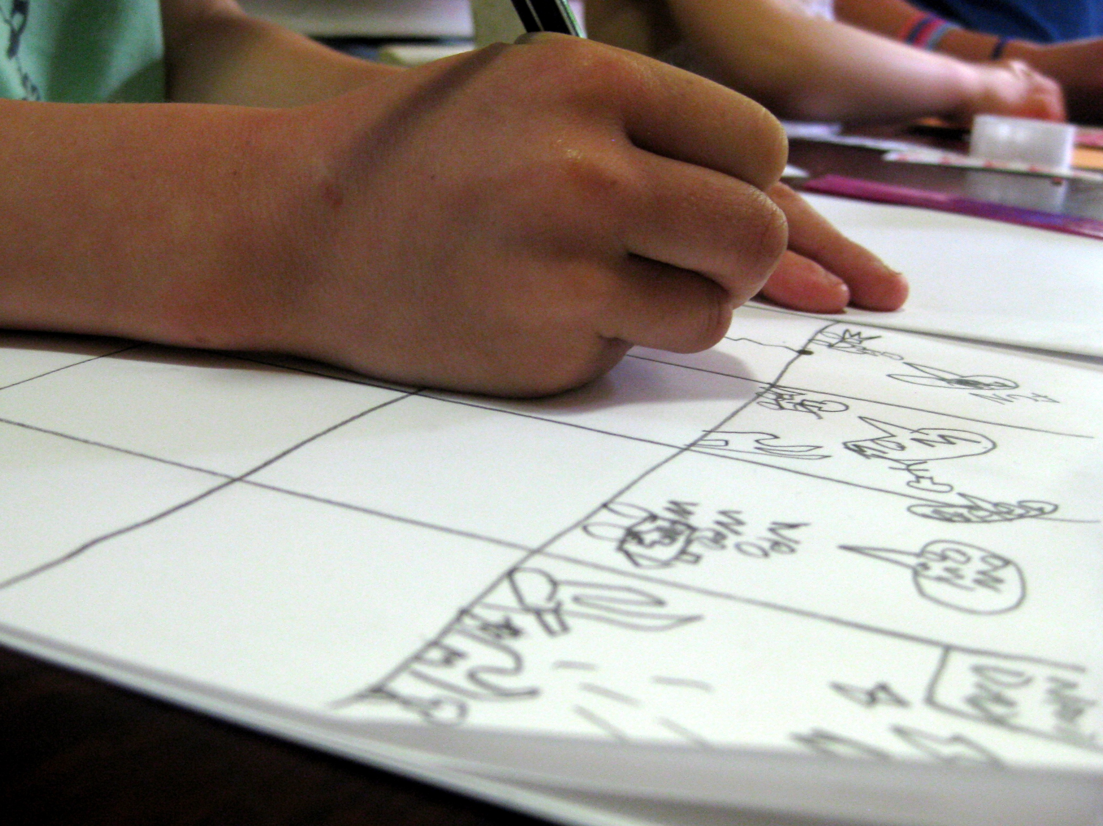
Having students illustrate is a key step in helping them to develop the skill of visualization when visuals are NOT provided. (which is most of the time!!)
It is helpful to practice “speed drawing” at the beginning of the year!

Slide 37
Students are familiar with comic strips as storyboards.
Start to look at storyboards with two goals:
© LClarcq 2015

Slide 38
Students are familiar with comic strips as storyboards. Start to look at storyboards with two goals:
Find what is IN the strip that you
can describe using
level-appropriate language.
© LClarcq 2015

Slide 39
Students are familiar with comic strips as storyboards. Start to look at storyboards with two goals:
2. Think about what is NOT in the pictures that could be referred to using level-appropriate language.
© LClarcq 2015

Slide 40
Look on the Internet for images that
spark interest, inspire conversation
and that (could) tell a story.
All of the following appeared using the search terms “father and son.”
© LClarcq 2015

Slide 41
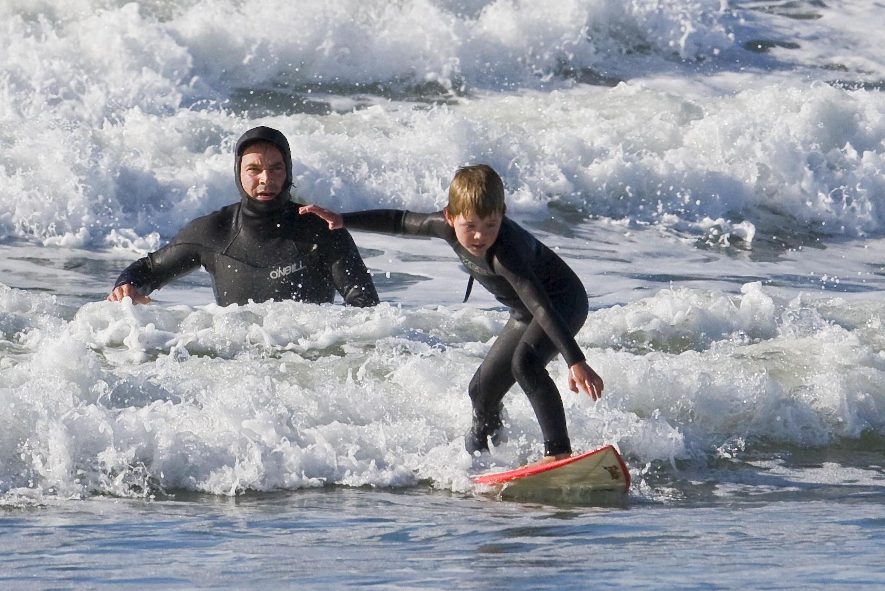

Slide 42
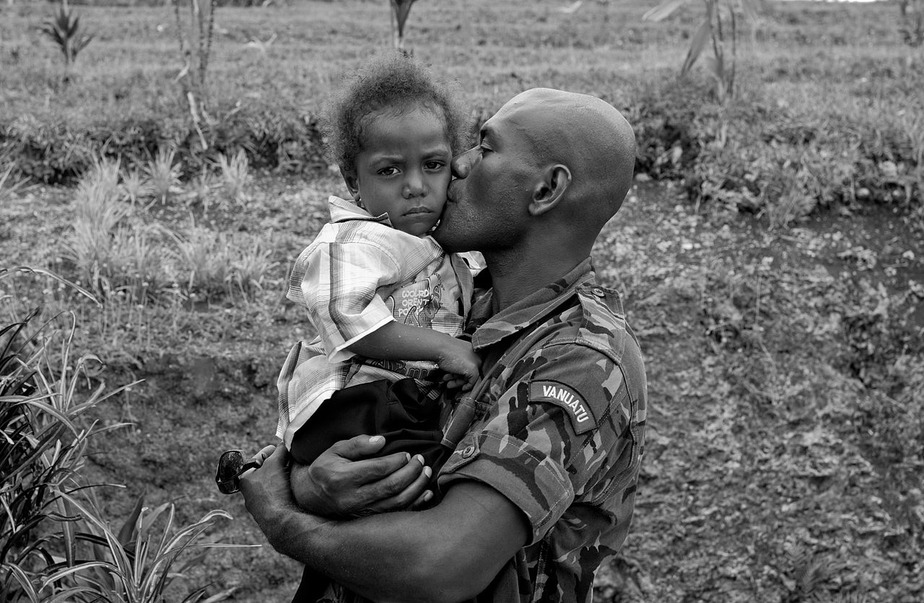

Slide 43
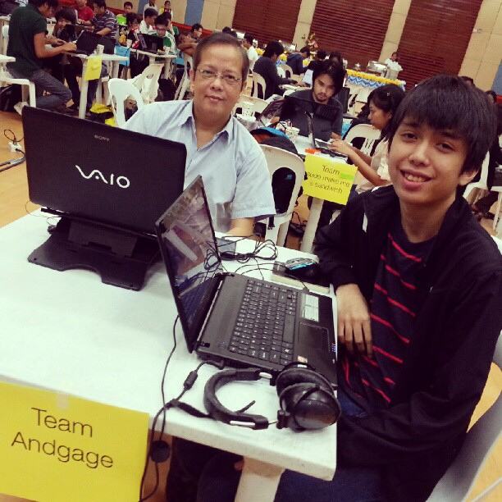

Slide 44
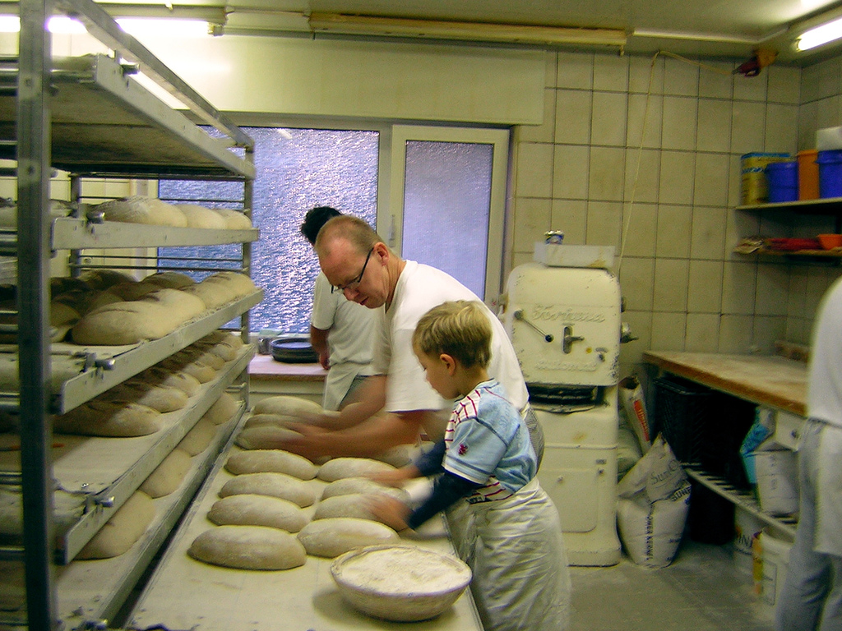

Slide 45
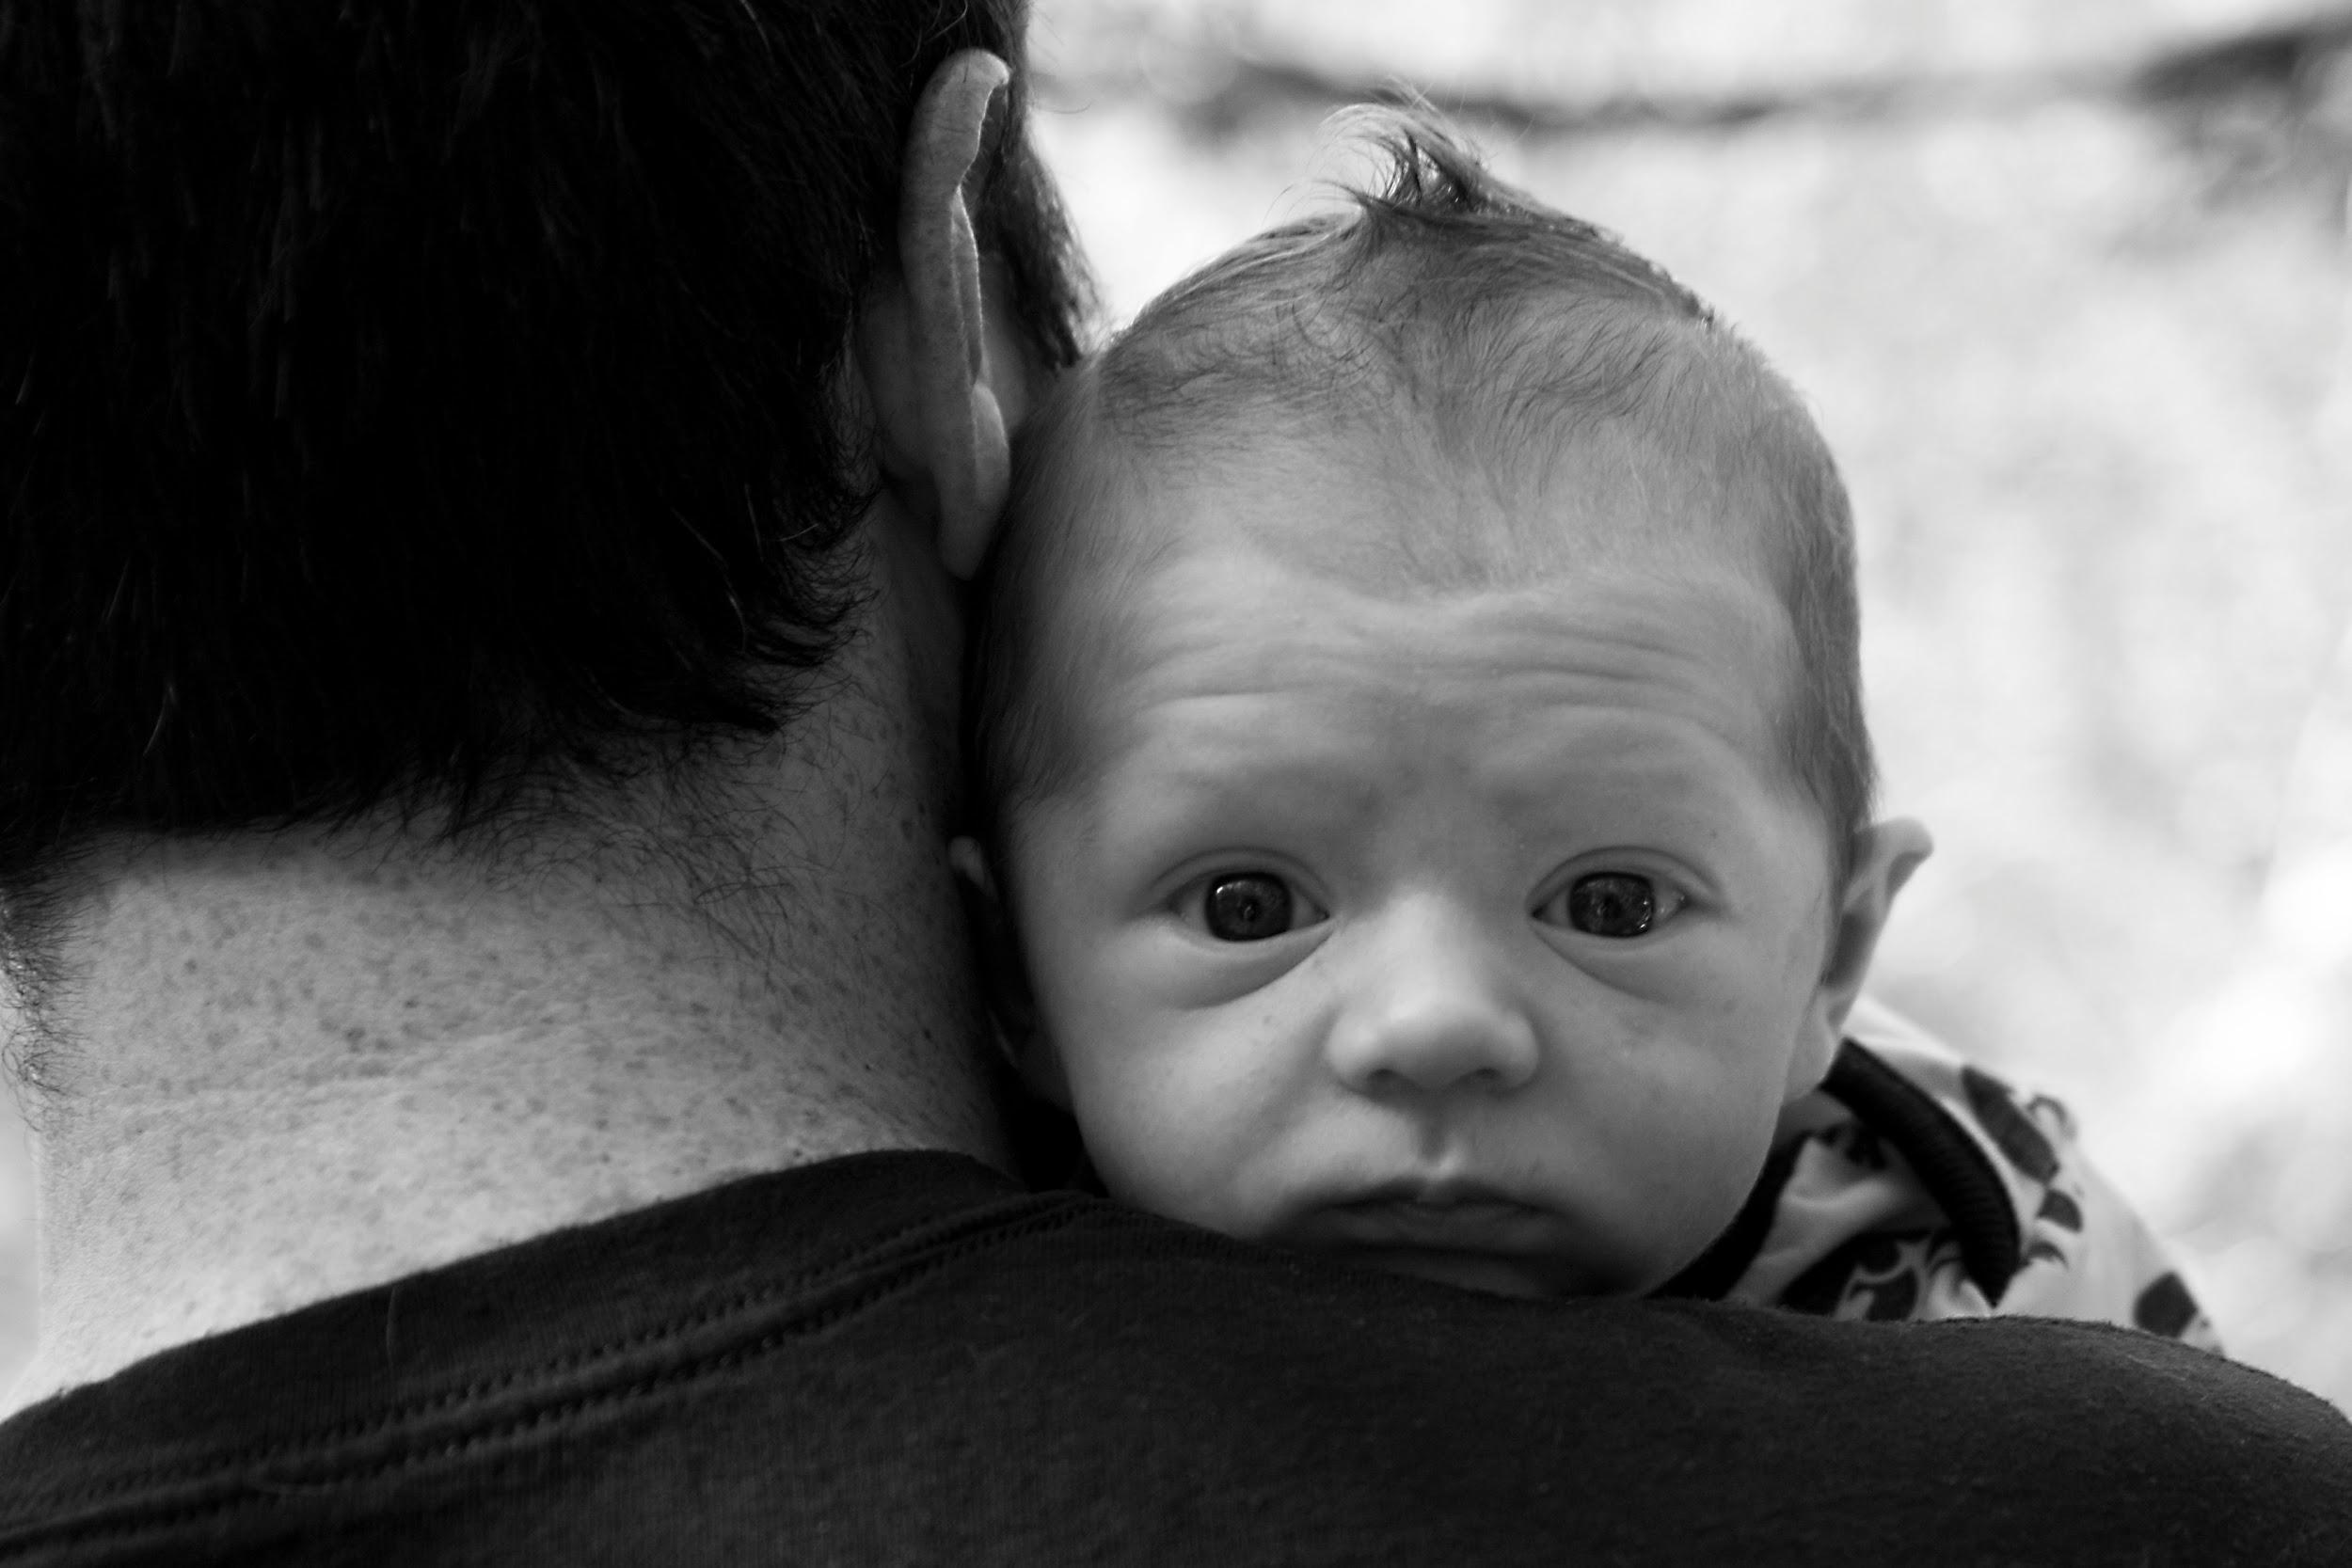

Slide 46
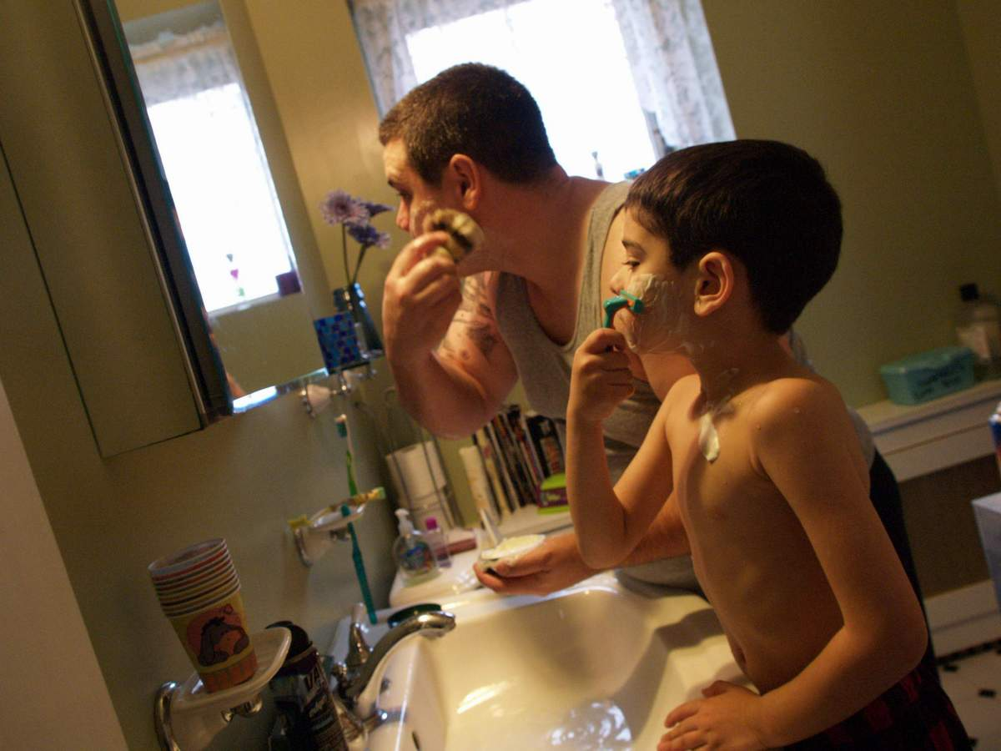

Slide 47
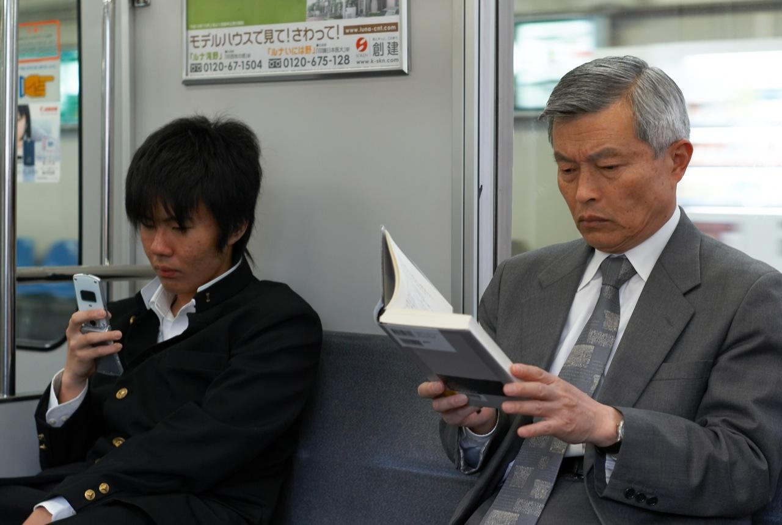

Slide 48
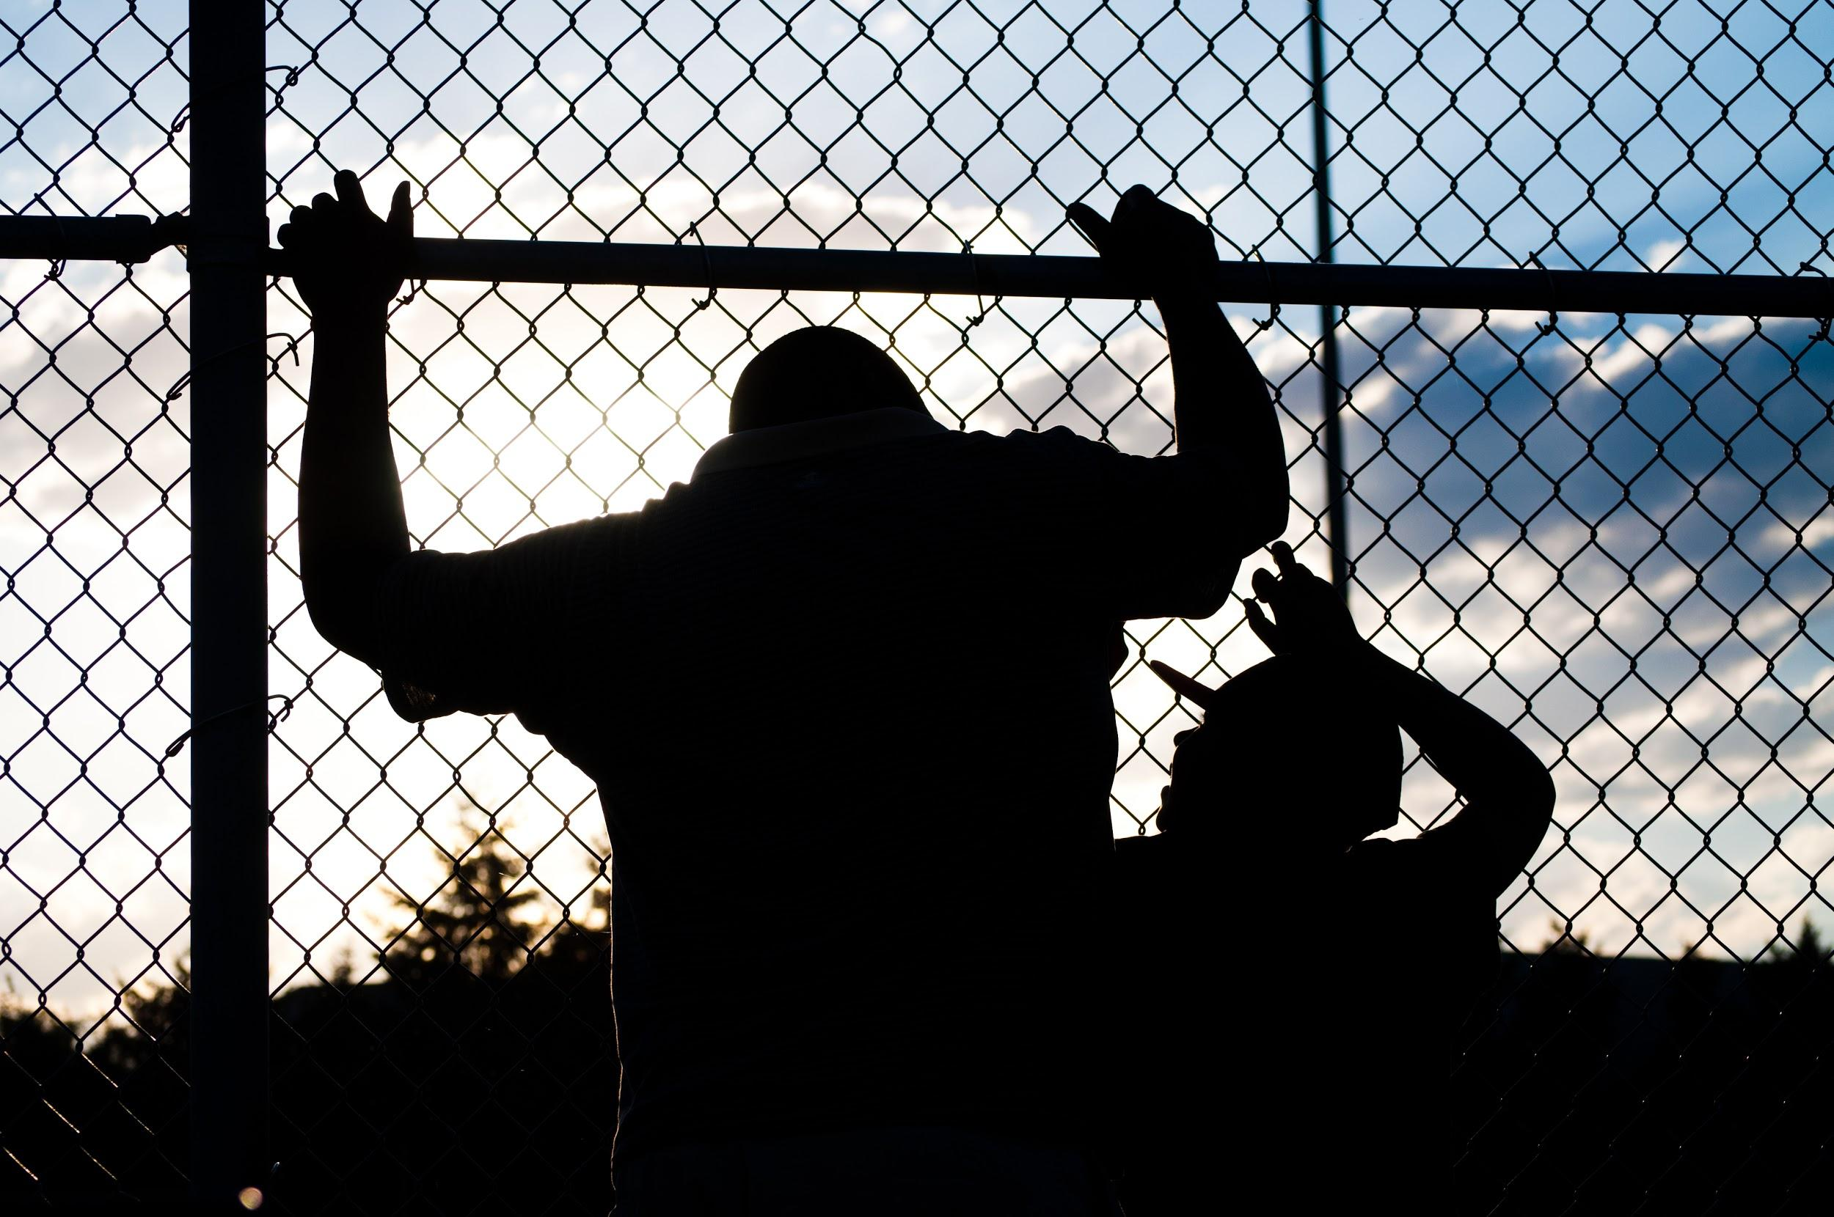

Slide 49
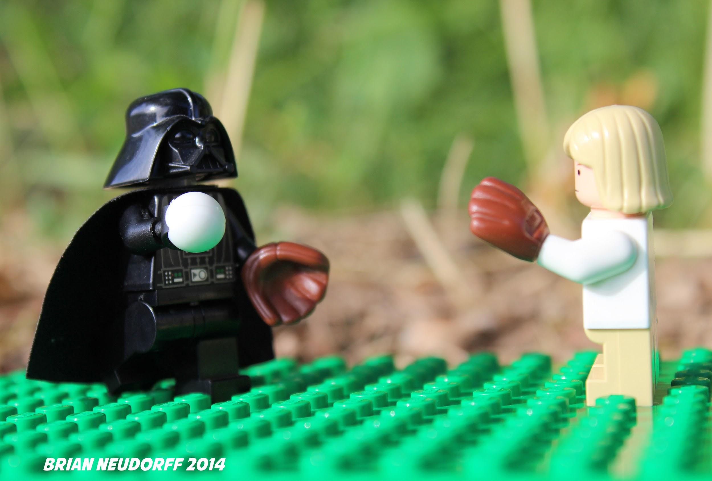

Slide 50
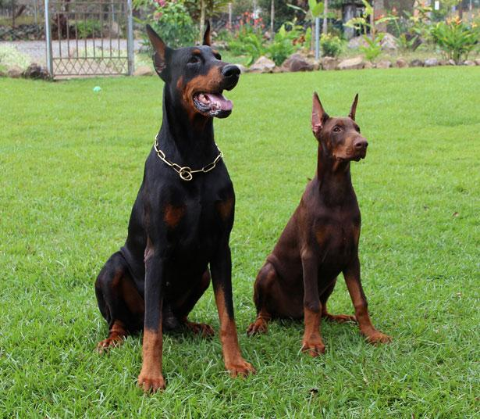

Slide 51
Our best source of images is our own students.
Use images from the school website
Invite students to email you images that would be appropriate to use for class.
© LClarcq 2015

Slide 52
Consider the use of well-known masterpieces as a visual…
Every picture tells a story!
Talk about what came before and
after the “moment” captured.
© LClarcq 2015

Slide 53
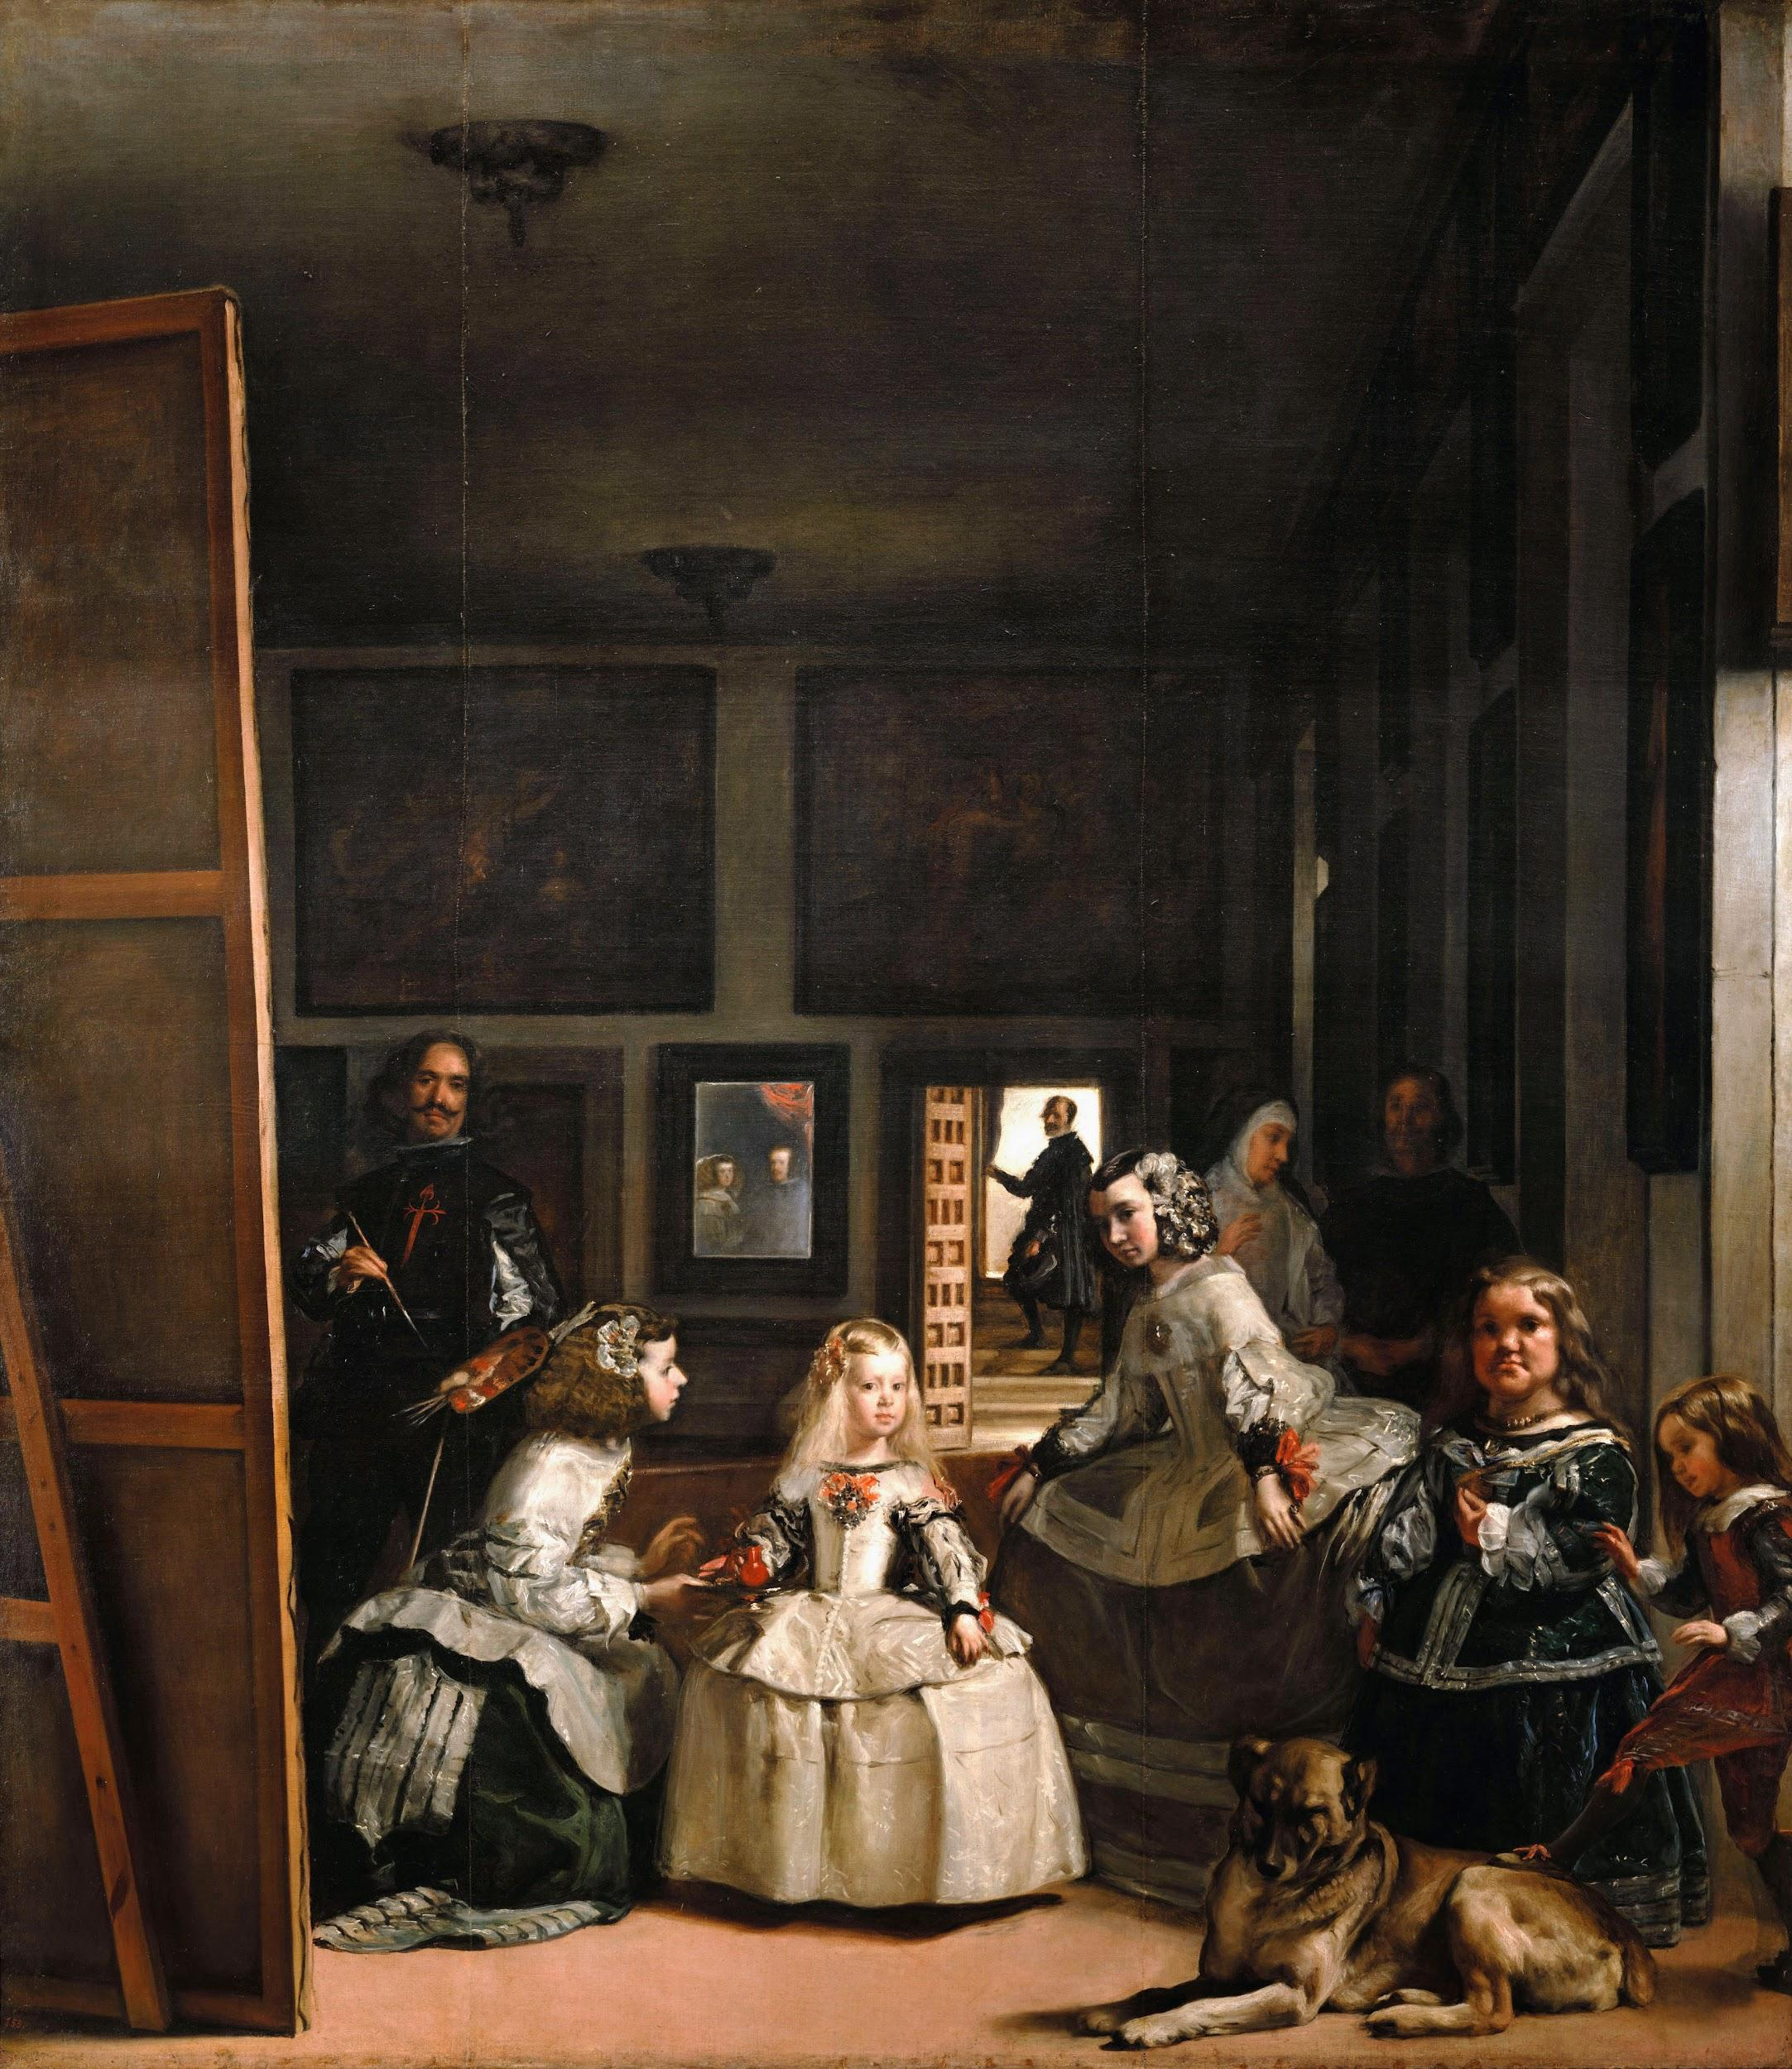

Slide 54
Consider the use of pictures of architecture.
Every picture tells a story!
Beyond description, discuss as a possible setting for a novel, a vacation, etc.
© LClarcq 2015

Slide 55


Slide 56
Consider the use of pictures of craftwork unique to a culture.
Beyond description, consider level-appropriate language and then think about how to go “deeper” using that language…..
© LClarcq 2015

Slide 57
This is a doll collection that belongs to my neighbor. Each of the dolls represents a phase in this woman’s life. What do you think was THE MOST IMPORTANT thing in the woman’s life at each of the stages represented?
© LClarcq 2015

Slide 58
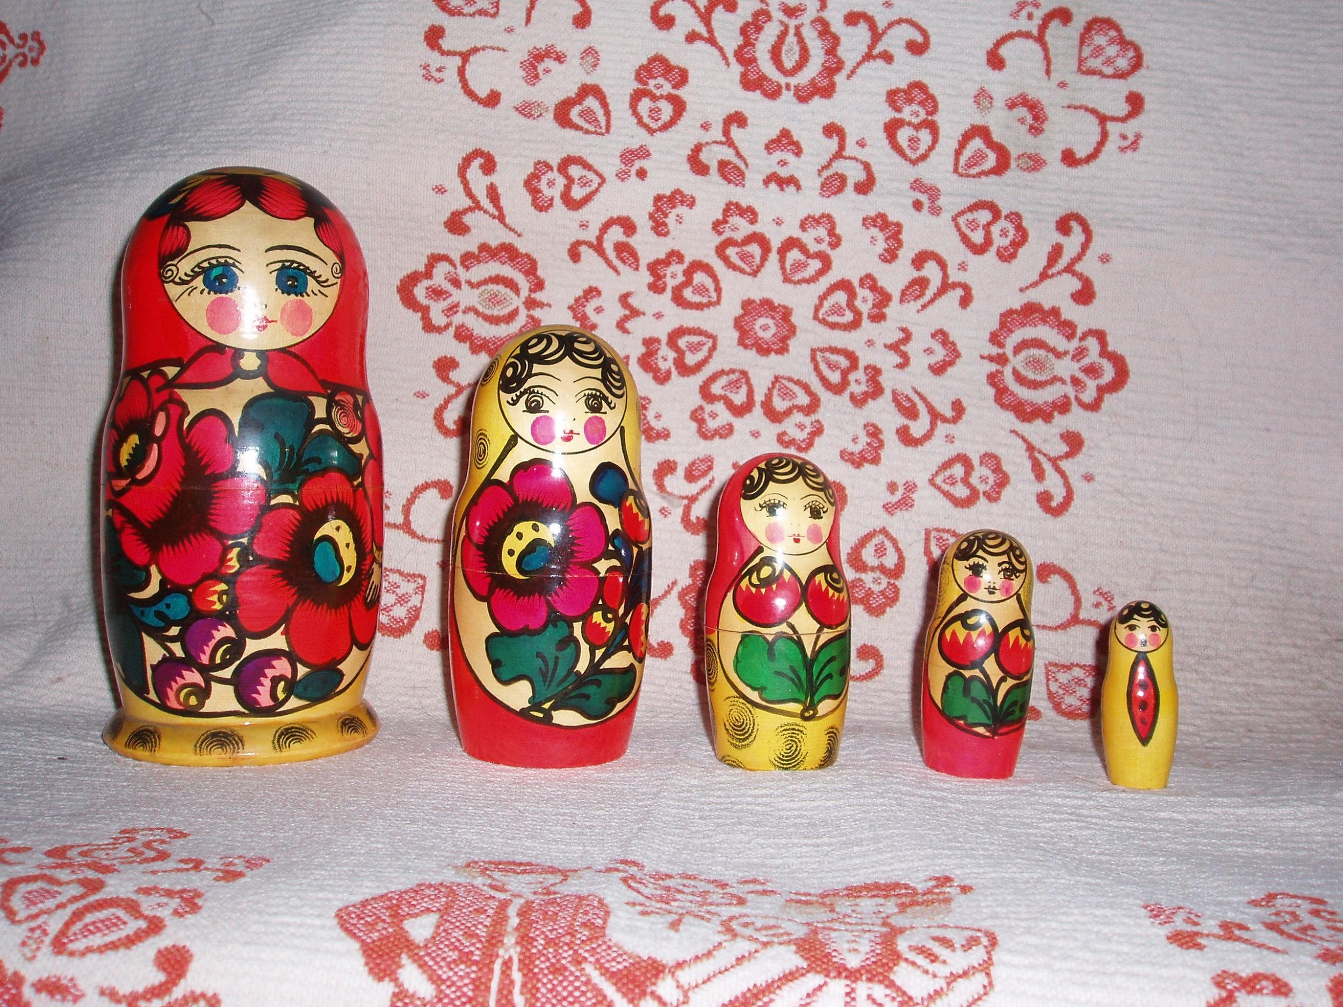

Slide 59
Movie Talk is a wonderful way to incorporate language and visualization in the classroom.
It was originally designed by Dr. Ashley Hastings for English Language Learners.
© LClarcq 2015

Slide 60
Movie Talk explanations and ideas:
http://martinabex.com/teacher-training/movietalk/
https://mjtprs.wordpress.com/2013/03/04/movietalk-video-suggestions/
https://www.pinterest.com/pin/243898136047176720/
http://tprsmovietalk.wordpress.com
http://palmyraspanish1.blogspot.com/2011/11/using-videos-with-tprs.html
© LClarcq 2015

Slide 61
The video below is a wonderful video to use for Movie Talk:
https://www.youtube.com/watch?v=JMJXvsCLu6s
© LClarcq 2015

Slide 62
The ability to visualize opens up
many possibilities for
comprehension…...and then
for connection…..
...in ways that words alone cannot.
© LClarcq 2015

Slide 63
All images courtesy of Google Images available via Google slides.
Please follow the guidelines provided by your school district when using images with your students.

